Slide 1
Asymmetric copula in multivariate flood frequency analysis
Hannes Grün, Robin Schüttpelz

Slide 2
Relevance
Floods: Among most severe natural hazards worldwide
Multivariate flood analysis: Interdependence of flood event characteristics
Asymmetric copula functions: Varying strength of dependence between variables, allowing flexible modelling.

Slide 3
Dependence Structure
Relevant Variables: Flood peak (P), Duration (D), Volume (V).
Influences on Dependencies: P affects dependence structure between D & V
Relevant Influences: Portray multivariate dependencies in accurate manner

Slide 4
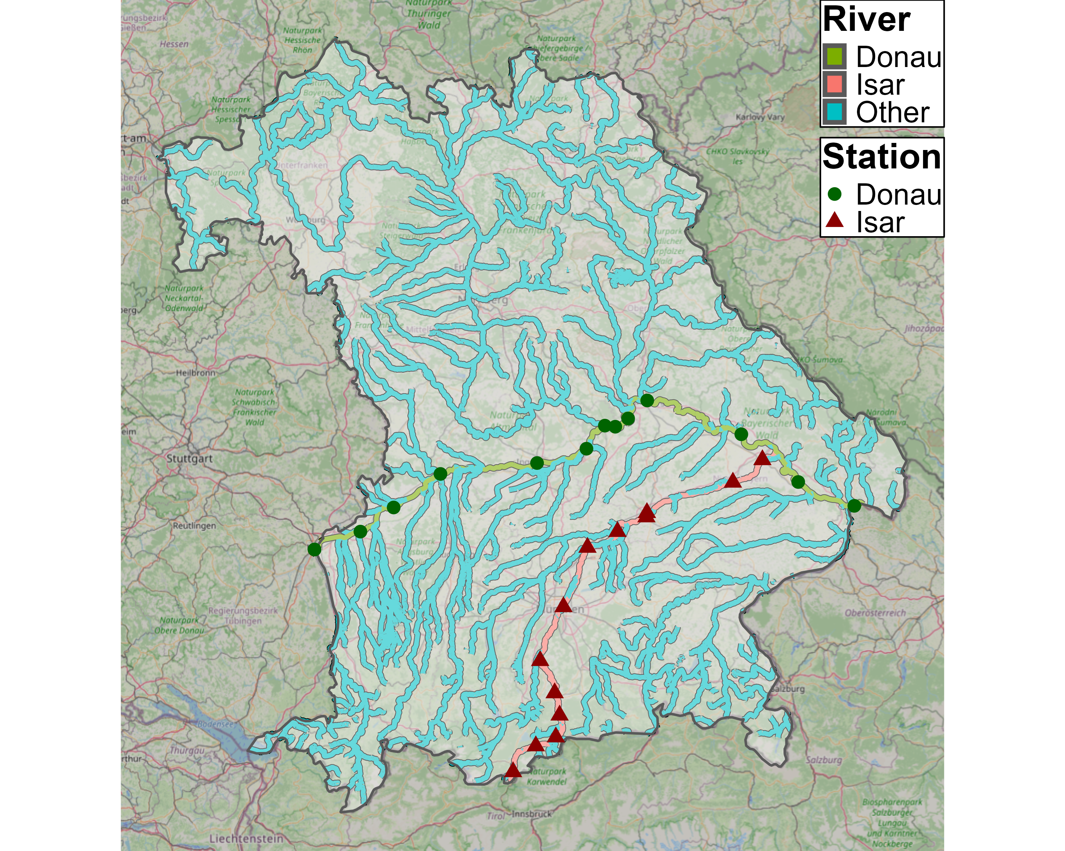
Data - Selection

Slide 5
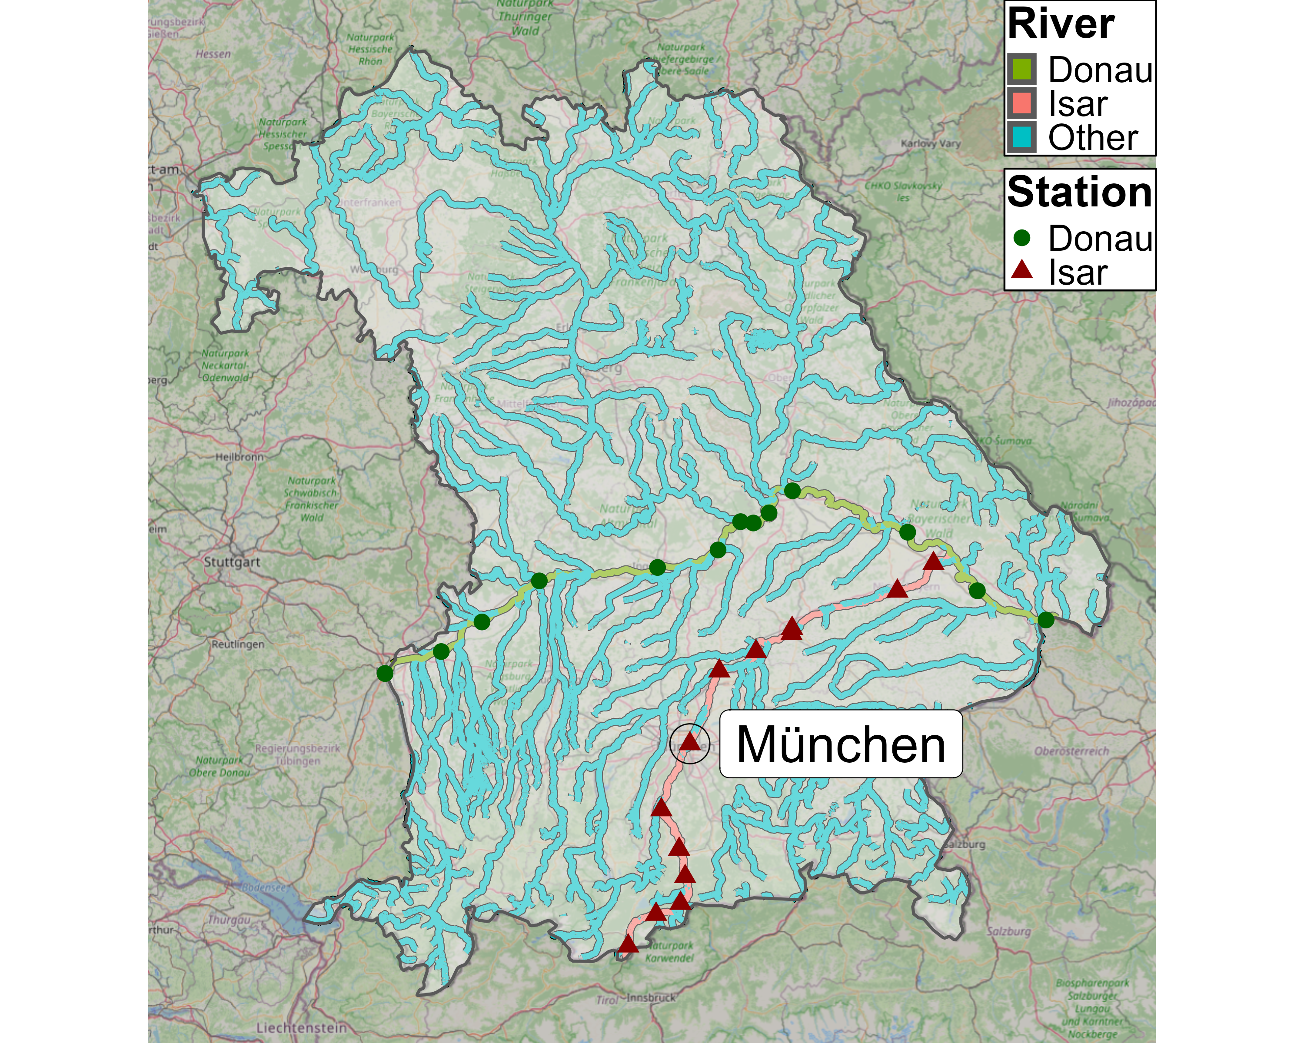
Data - Selection

Slide 6
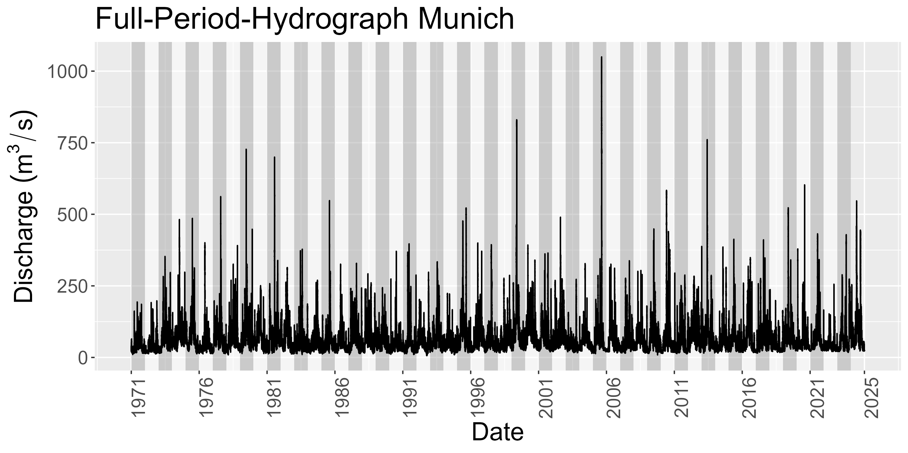
Data – Munich Station
Notes:
Hydrograph over 54 years
See later: number of years are number of observations per station

Slide 7
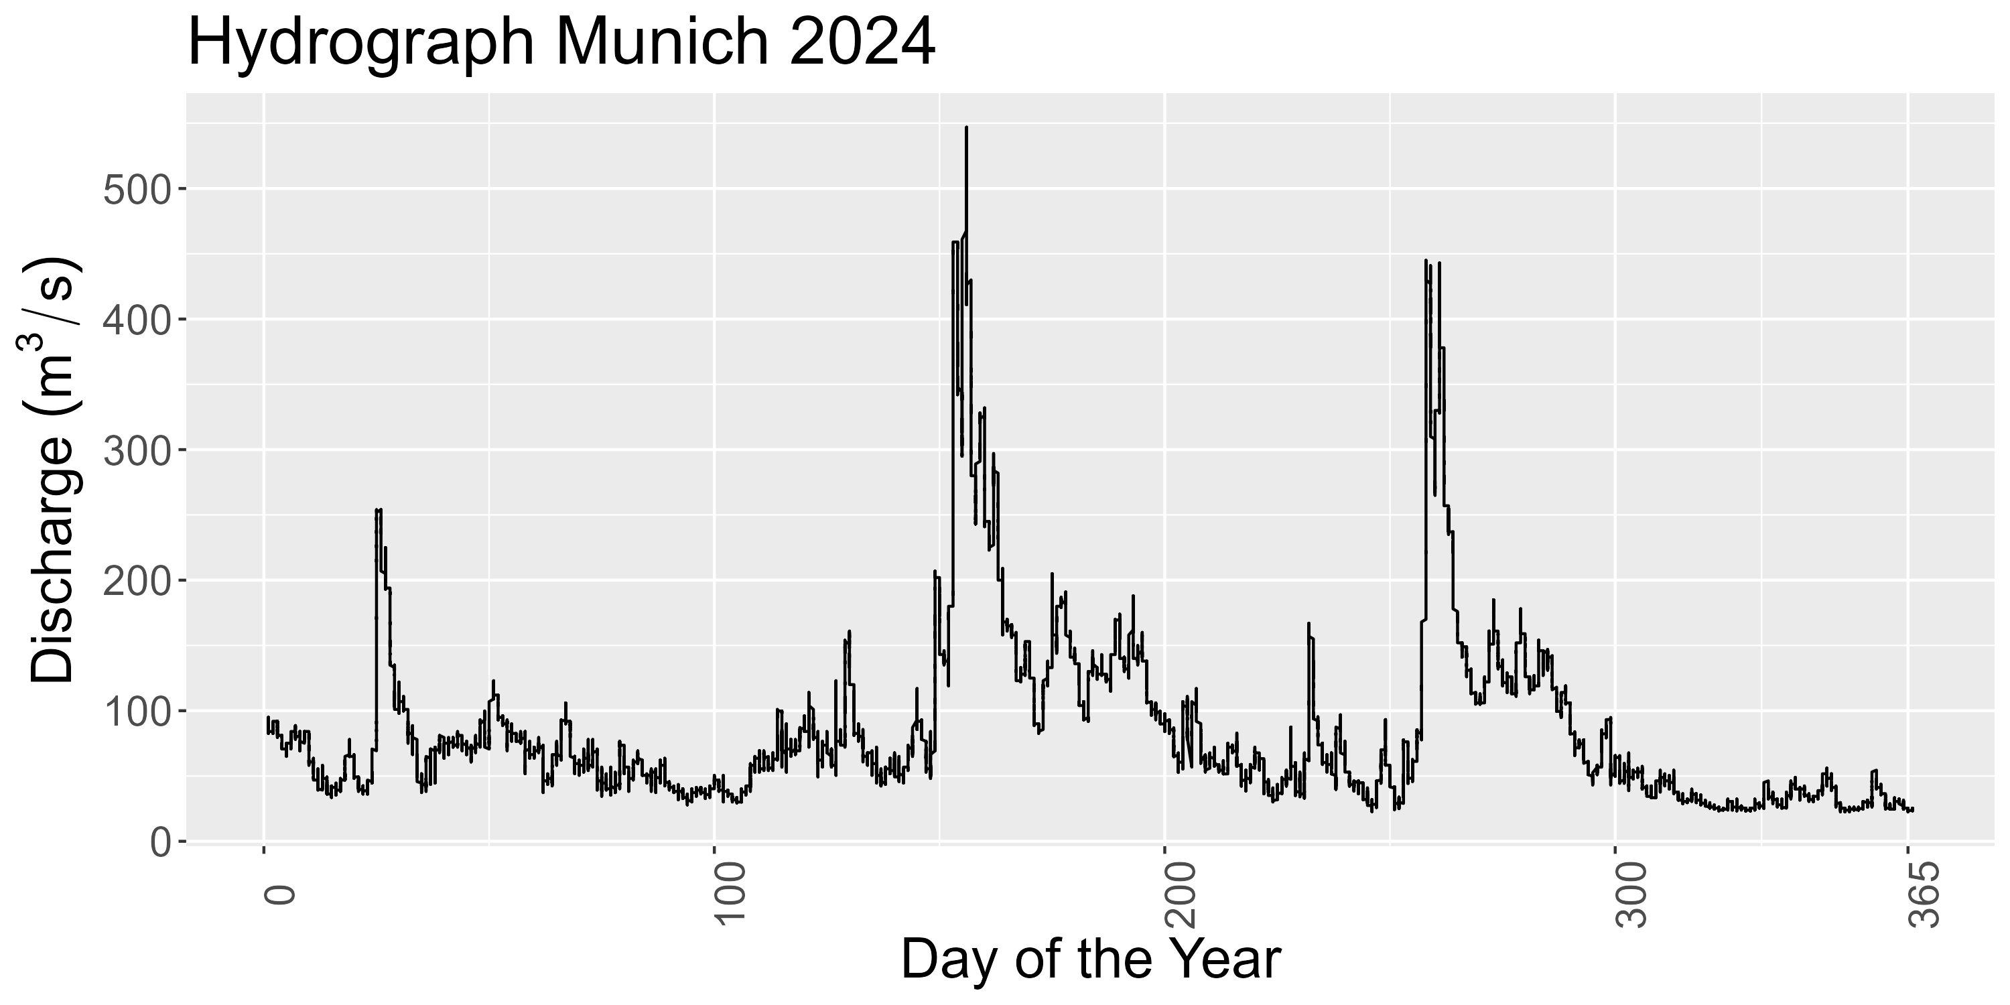
Data – Munich Station

Slide 8
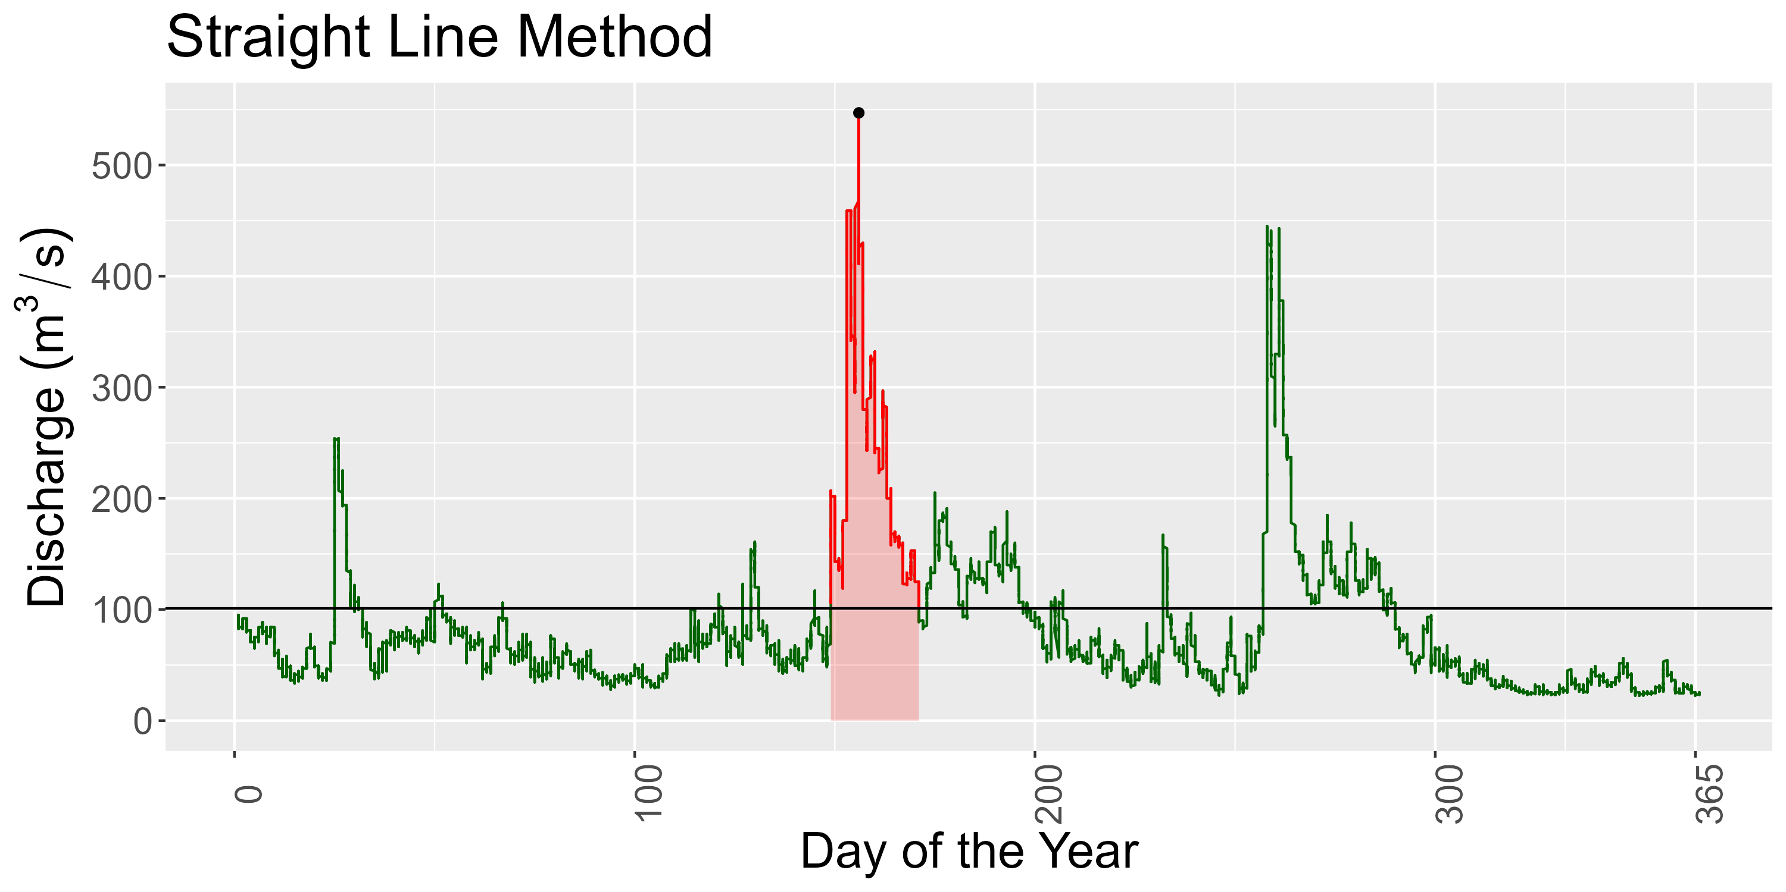
Data – Munich Station
Notes:
Contrary to the paper, we do not use fixed threshold
Reason: Fixed threshold is not reasonable IMO bc we are intersted in the dependence strucutre
Dependence structure / correlation is scale independent
Exact values:
Peak: 547
Duration in days: 22.1
Vol in Mio: 446

Slide 9
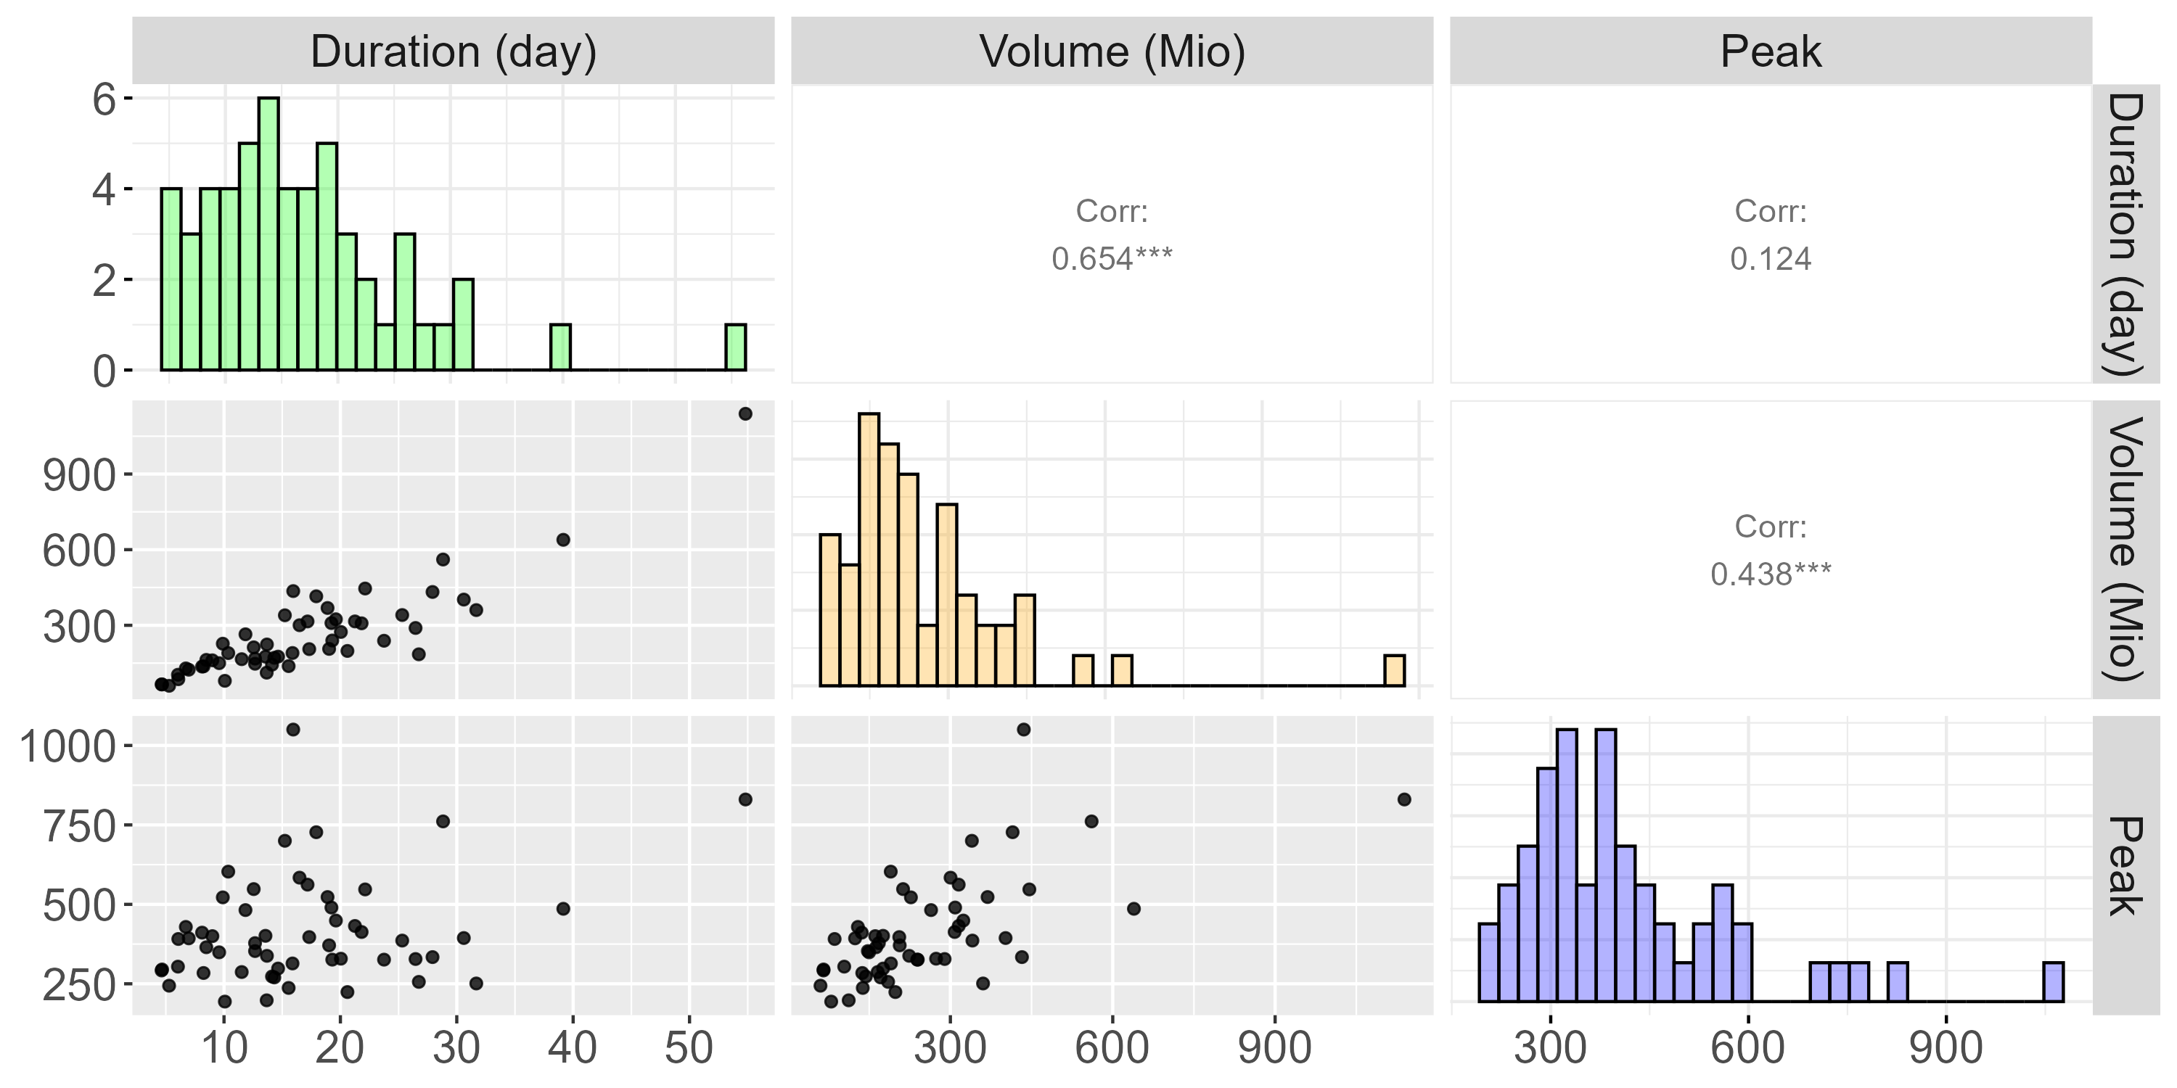
Data – Munich Station
Notes:
Do that for every year to obtain nobs = #years observations
This data used to fit station specific copula

Slide 10
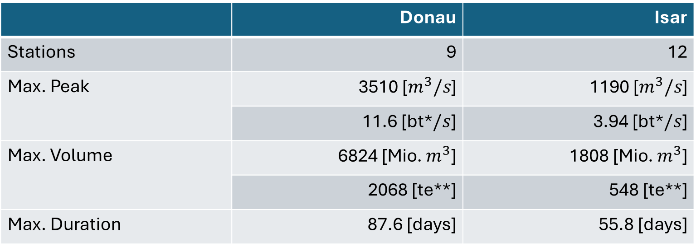
Data – Summary
 | Donau | Isar
Stations | 9 | 12
Max. Peak | 3510 [$m^{3}/s$] | 1190 [$m^{3}/s$]
 | 11.6 [bt*$/s$] | 3.94 [bt*$/s$]
Max. Volume | 6824 [Mio. $m^{3}$] | 1808 [Mio. $m^{3}$]
 | 2068 [te**] | 548 [te**]
Max. Duration | 87.6 [days] | 55.8 [days]
*bt denotes unit „bathtub“
**te denotes unit „Therme Erdingen“
Notes:
2 Rivers, 27 stations where: 6 have below 30 observations -> remove those bc pretty little infor for following methods
After removing: 2 Rivers, 21 stations: Donau: 9, Isar 12
Majority of stations have sample size of 54 with only 2 stations nobs between 44 and 50
In total, we have data on 1122 flood events
Largest observations by river:
Max peak in Donau: 3510 -> that is 11 Bathtubs/s
Max peak in Isar: ~4 bathtubs/s
Max vol in Donau: 6824 -> That is 2068 x Therme Erdingen (Flood took 46 days; in year 1988)
Max vol in Isar: 548 x Therme Erdingen (Flood took 48 days; in year 1999)
Max Duration Donau: 87 days
Max Duration in Isar: 56 days
Duration Reminder: A river is flooded as long as its discharge is above ist 75% quantile;
i.e. It took 87 bzw. 56 days for the discharge to drop below the 75% quantile within that year

Slide 11
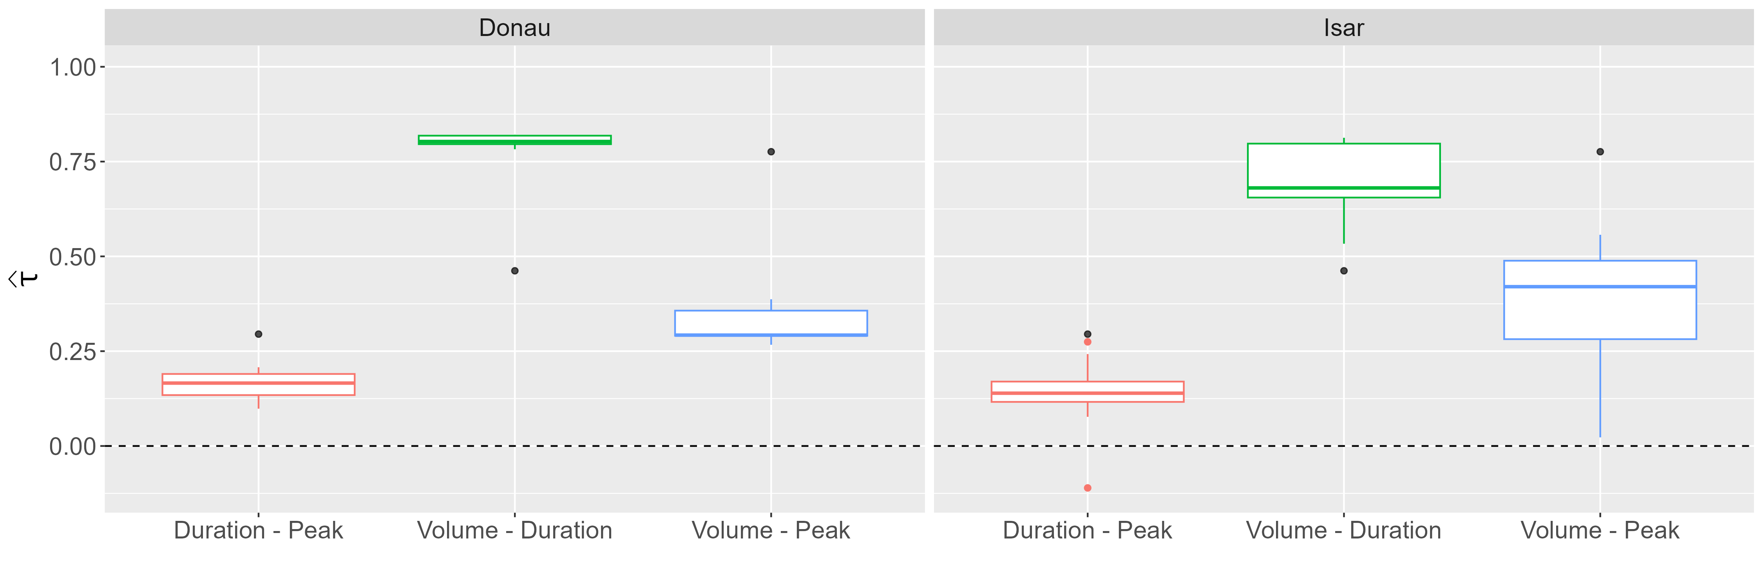
Data – Correlation
Notes:
Boxplots:
Distribution for all Kendall Correlation Coefficients
Tau higher variation in Isar, one correlation even below 0 (Mittenwald)
Important to note: There seem to be three distinct correlation values / three distrinct strength of dependence (Like already seen for Munich station)
Volume-Duration largest by far, then Volume-Peak, then Duration-Peak. This holds for both rivers
The Black Dots the taus observed in the paper. And as seen in the paper, the degree of dependence between these variables depends on the threshold of when a flood is considered as such
Different to the paper: We choose quantiles to define a flood, paper used fixed value
For large threshold, Peak-Volume dependence INCREASES while (paper p 1162) while for others
That is, the behavior we saw for the Munich station does also hold for the other stations
This is VERY important because it implies the violation of NACs
Here critizing the paper:
The paper applies NACs without every showing scatterplots or the correlation among the variables. When comparing our analysis to their, we missed those
Thus, we are uncertain if NACs were applicable to the data in the paper?
In our simulation study we will see what happens if NAC applied to vine DGP
>> This brings us to methods part ☺

Slide 12
Methods
Archimedean Copulae
(Fully) Nested Archimedean Copulae
Vine Copulae
Notes:
We apply copulas
Quick reminder:
Copula is a joint cdf with uniform margins (more on that later. For now think of it as just a function)
Allows to decouple marginal distribution and dependence strucutre
Copulas are how multiple weels to tweak:
Symmetry in a copula
Here: Focus on Archimedean copula → These are exchangeable (More on that during generators)
Speaking of generators:
Generators define the family a copula is from (Again, more on that on another slide)
These properties refer to bivariate consideration. We consider trivariate copula
Building blocks of trivariate copula is still the bivariate copula
Different Nesting / Conditioning Structure give different Copula
We consider three type of trivariate copulas
Goal here: Copulas are math heavy
Usually you will see „Sklar‘s Theorem“ on which copulas are based on
Goal here: Keep low in math
Thus: Start with the building blox and of bivariate copula and go deeper into the aforementioned propertie

Slide 13
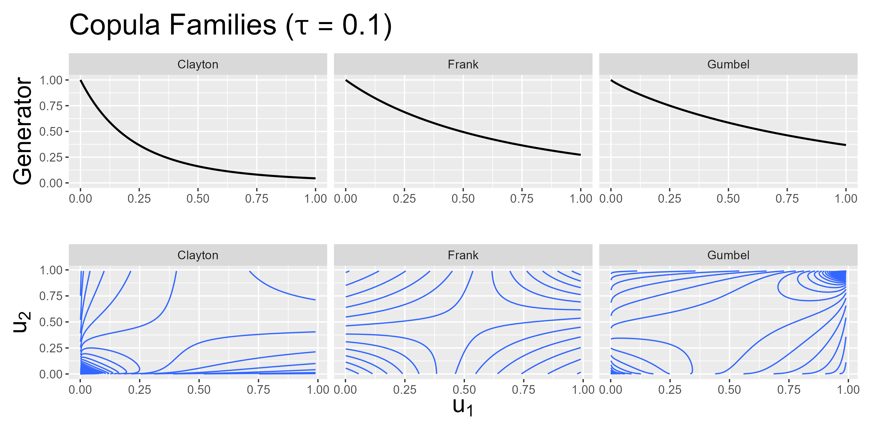
Methods - Generators
Notes:
What are Archimedean copulas? What is exchangeability? And what is a copula family?
Before diving into these questions:
Consider the axes of the plots. They reach from 0 to 1.
This is because, before applying copulas, we transform our data using PIT
Discussed this in Interim meeting
If not remeber it: Just know there exists a function such that we can always transform our data into the 0,1 domain
Everything that follows is applied to this transformed data
Now, what are Archimedean copulas:
Copulas defined by a generator function
We focus on three different archimedean copulas: Clayton, Frank and Gumbel
You can see their generators on the top row
Imagine generator functions as building blocks of an archimedean copula
You plug in the transformed variables into these functions and jointly this gives you the final copula (See Archimedean copula in generator functions later on)
Generator functions depend on a parameter value and estimating a copula means we estimate this parameter of the generator
Finally, since copulas describe the dependence structure in the data:
Copulas are connected to correlation
That is, the PARAMETER of the generator function is connected to the correlation in the data (thus, tau = 0.1) on the top
What are are Archimedean copula families
Depending on the generator function, the contour plot on the bottom change
But more on that later, when we consider higher correlation
Then, effect of family / generator function is more clear
Finally, what is exchangeability:
In contour plots, imagine a line from bottom left to top right
This is the axis for which the contour plots are symmetric
This implies that the order in which the variables are plugged into the copula do not matter (More on that when considering AC)
Learning now that generators exist, we can further talk about copula families
Gumbel, Clayton, Frank
Each family defined by is generators
Generator depends on one paramter bzw. on tau
> Estimating this parameter / tau and asuming a copula family gives full BIVARIATE dependence structure
> Plot each and discuss properties / tail dependence
!! Add 1-u and survival copula into appendix!
! Explicitly mention the x –axes in both plots

Slide 14
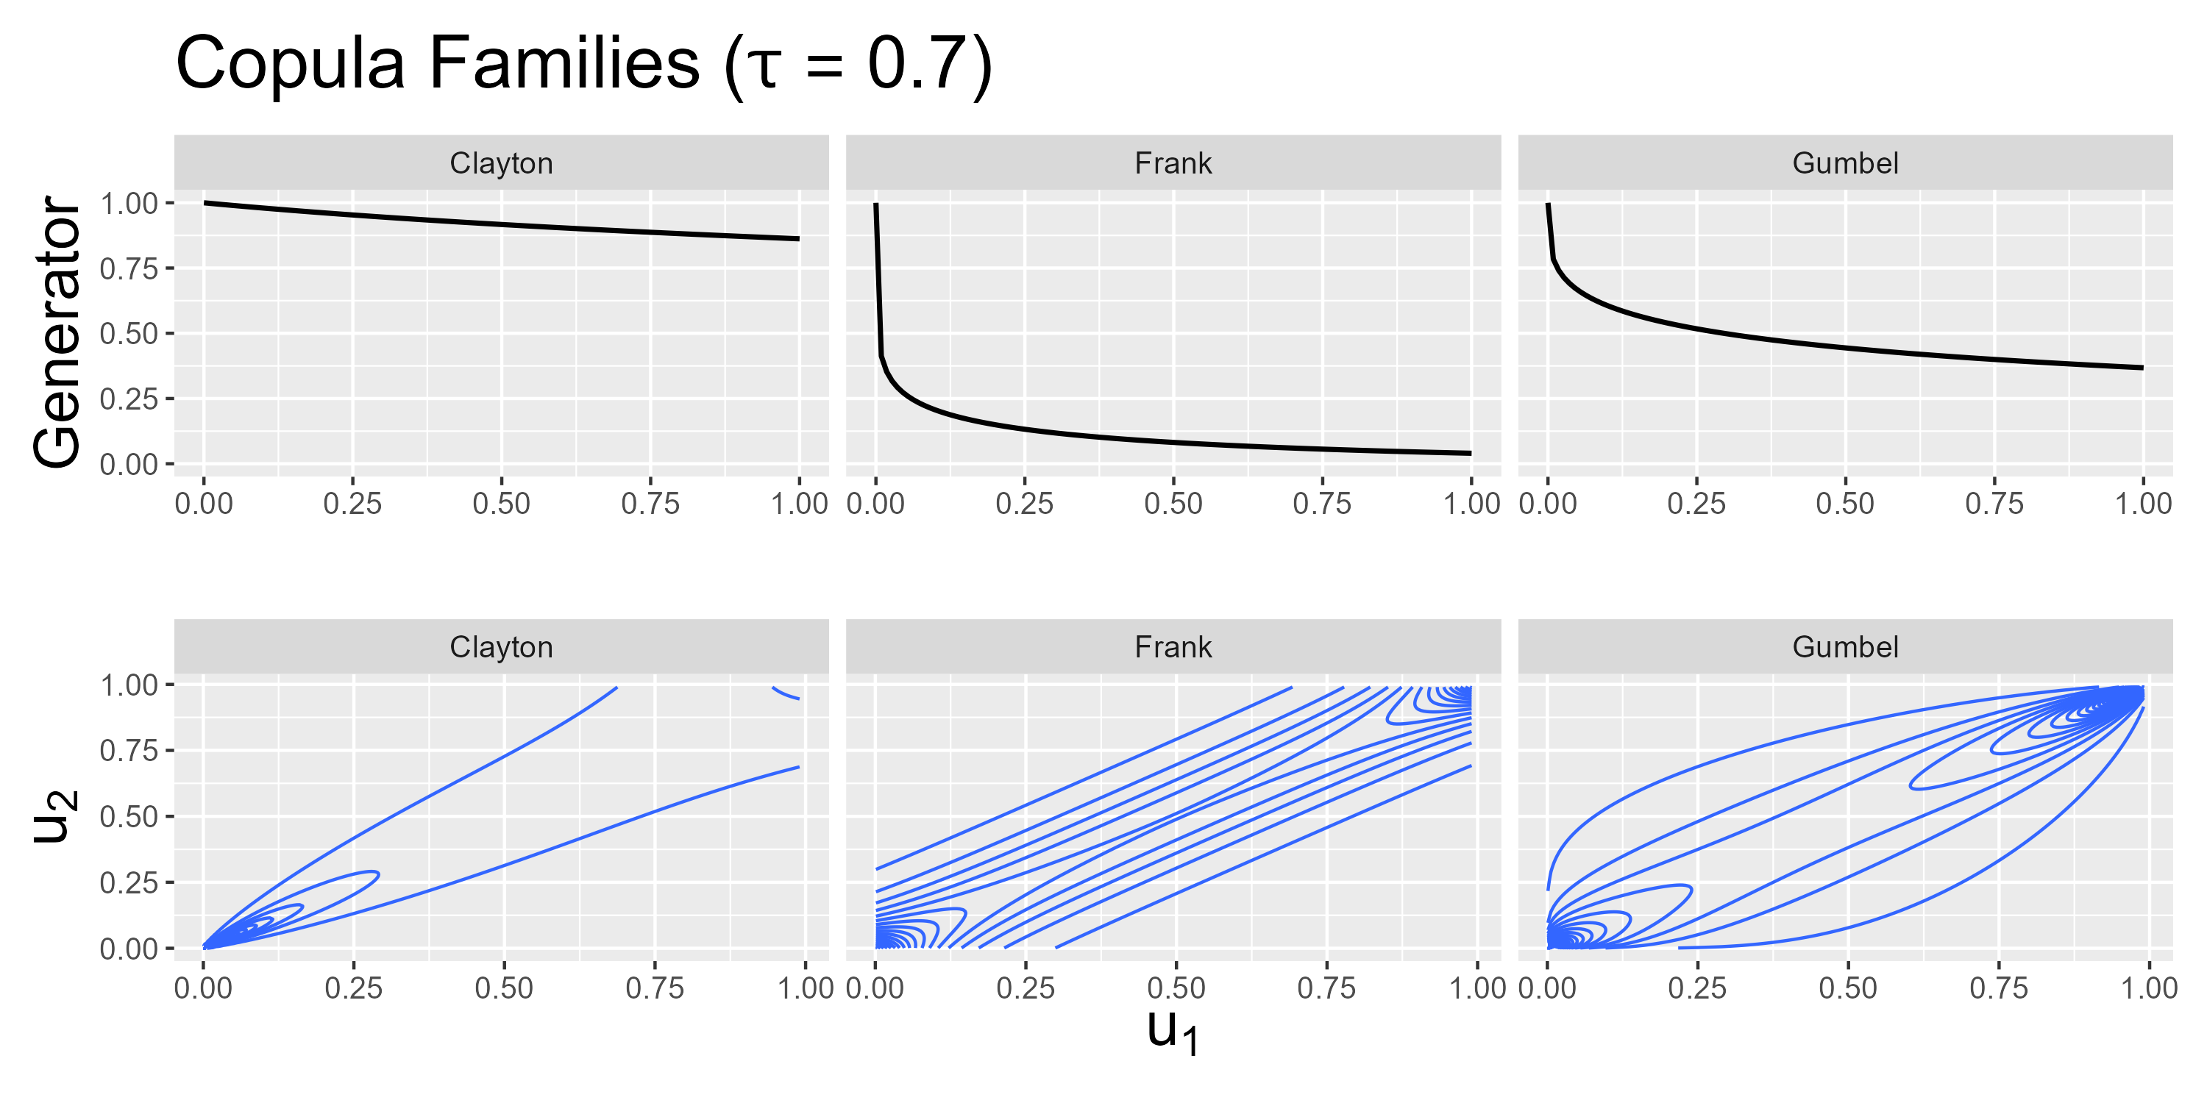
Methods - Generators
Notes:
Consider what happens if the dependence increases (i.e. when tau increases from 0.1 to 0.7)
The behavior of the generator changes
Thus: DENSITY Contour plots change
Now the difference between copula families is more clear, especially, the implied behavior of the data for extreme values
Clayton (left): For low values of u_1, u_2 also tends to have small values. This is not the case for large values → LOWER taildependence
Gumbel (right): For high values of u_1, u_2 also tends to have large values. NOT THE CASE FOR SMALL VALUES? → UPPER taildependence
Frank (center): No dependence for low, nor for high values → NO taildependence
So we established what we can tweak in a bivariate case
That is, we know about the building blocks for a trivariate copula
The structure in which we can combine these bivariate copulas to obtain a trivariate copula is now discussed

Slide 15

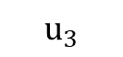
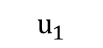
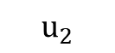
Methods - ACs
$$C\left(u_{1},u_{2},u_{3}\right)=φ^{[−1]}(φ\left(u_{1}\right)+ φ\left(u_{2}\right)+ φ\left(u_{3}\right))$$
$$C$$
$$u_{1}$$
$$u_{2}$$
$$u_{3}$$
Notes:
The simplest trivariate case is trivariate AC
3 things to notice:
On top: This is how the generator function phi is used to build a Archimedean copula
Number of generator functions used / copulas you see in the tree is the number of possibly unique dependence structures
Here: We have this one C in the tree that is the AC implies all three variables have the same dependence
Also: Exchangeability: Changing the order of how we plug in the us does not change the value of C
This implies a limitation on the data:
Assuming that the true copuls is of simple AC, the data needs to suggest the same type AND strength of dependence between variables
(Also strength, bc one generator function is used and the parameter of generator depends on strength of dependence)
For us: Fitting a simple AC implies assumption that correlation between peak, volume and duration is identical

Slide 16

Methods - NACs
$$C\left(u_{1},u_{2},u_{3}\right)=C_{1}\left({u_{1},C}_{2}\left(u_{2},u_{3}\right)\right)$$
$$C_{1}$$
$$u_{1}$$
$$C_{2}$$
$$u_{2}$$
$$u_{3}$$
Notes:
NACs: As name suggests, we nest copulas
In trivariate: We nest the bivariate copulas resulting into the tree above
Applying number of copulas = number of unique dependence:
For THREE variables, we can only display TWO unique dependence structure
Limitation here:
Partically exchangeability: Order in which we plug u2 and u3 in does not matter
Thus: Applying NACs implies assumption hat two dependence structures in the data is the same
As seen in data part, this is not the case
Thus, we extend the paper copula approach by VINE copulas
Also paper citique here:
They applied NACs even tho (black dots in boxplots) assumptions were too restrictive

Slide 17
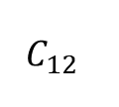
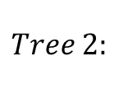
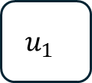
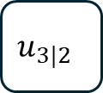
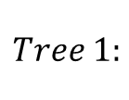
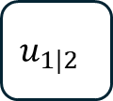
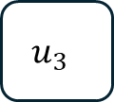
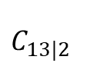
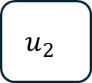
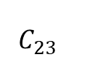
Methods – Simplified Vines
$$c\left(u_{1},u_{2},u_{3}\right)=c_{12}\left(u_{1},u_{2}\right)c_{23}\left(u_{2},u_{3}\right)c_{13|2}\left(u_{1}\left|u_{2},u_{3}\right|u_{2}\right)$$
$$C_{12}$$
$$C_{23}$$
$$Tree 1:$$
$$u_{1}$$
$$u_{2}$$
$$u_{3}$$
$$C_{13|2}$$
$$Tree 2:$$
$$u_{1|2}$$
$$u_{3|2}$$
Notes:
Note, the above function now is the copula density
Obtain the copula itself by integration, but just a side note. Not really relevant now
Vines
No nesting of copulas
Instead: 3 bivariate copulas with one being a conditional copula
Applying # cops = # unique dependence → We have 3 unique dependence structure that is, we can unique model every dependence structure in the data!
i.e. NO limitation for dependence strcutre → Well suited for our case as seen before from the correlation boxplots
Takeaways / Expectation:
Seen from data, we anticipate 3 different strength of dependence
We expect Acs and NACs to be infeasible for this reason
To examine vine performances – in case underlying is NAC even tho we think it is non-NAC – run simulation
Also, can validate paper results PLUS extend their results: They only compared AC vs NAC, now we extend this by comparison of NACs vs vines

Slide 18
Simulation – Setup
Parameter | Value
Sample size | 15, 30, 50, 1000
Correlation | Donau, Isar, LowHighHigh, LowMedHigh
Iterations per setup | 3000 (NACs) -> 1k each cop fam 27000 (Vines) -> 1k each combination of fams (3^3)
Copula Families | Gumbel, Clayton, Frank
Notes:
Reason to draw family type etc randomly: Saves a bunch of for-loops when implementing and due to large number of iterations, fraction will tend towards selection probability. i.e. Equally selection of combinations
> GOOD QUESTION TO BE ASKED

Slide 19
Simulation – NAC DGP
Notes:
Mainly about confirming paper simulation finding AC vs NACs, but also check Vine performance if NAC true
KLD by sample size over all correlation types and copula families
KLD and Paper confirmation

Slide 20
Simulation – Vine DGP
Notes:
KLD

Slide 21
Simulation – Vine DGP
Notes:
- Overestimation NAC

Slide 22
Simulation – Vine DGP
Notes:
- AIC discussion

Slide 23
Results

Slide 24
Summary
TODO: Show this as last slide and display Key findings.
So ppl can refer see everything and can refer to it

Slide 25
Appendix

Slide 26
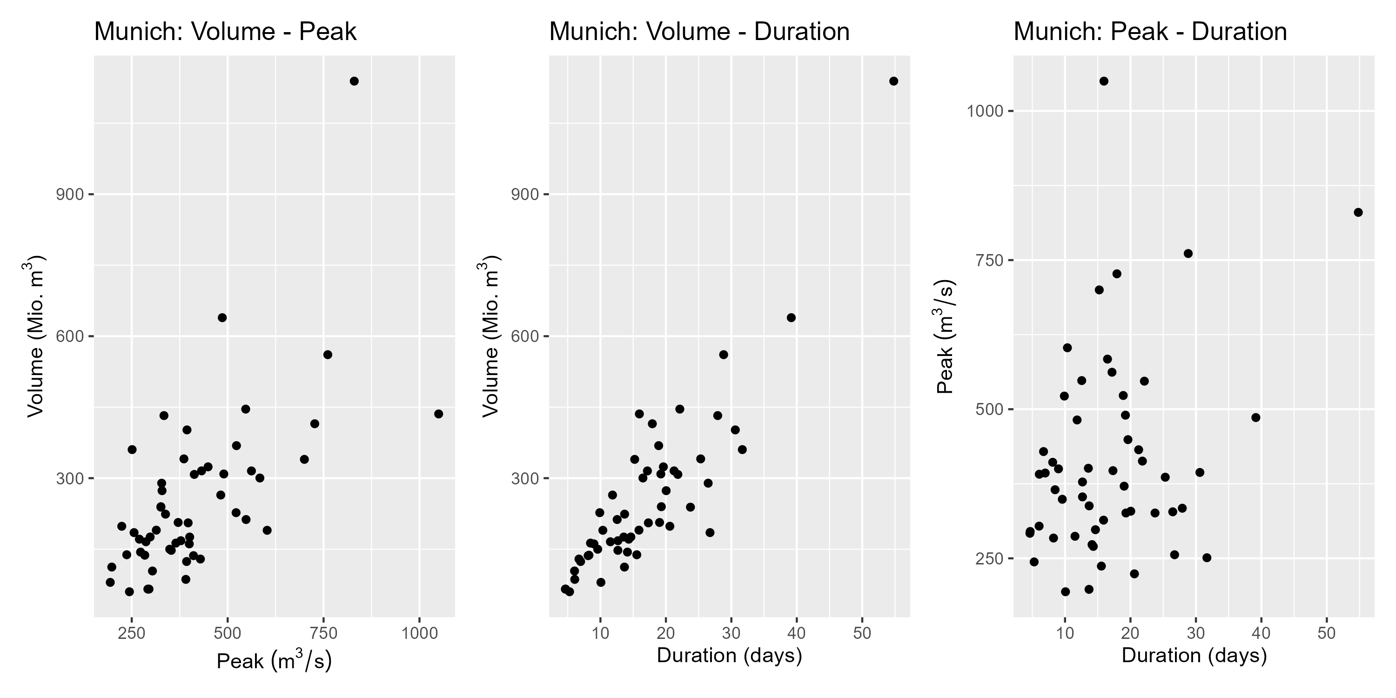
Appendix

Slide 27
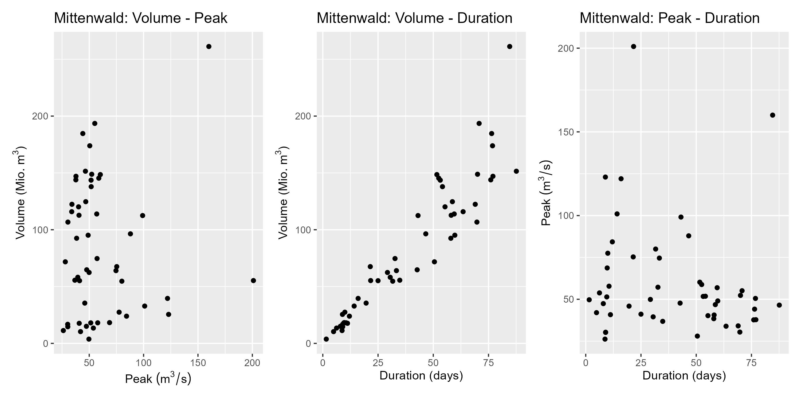
Appendix
Notes:
Negative correlation for duration-peak

Slide 28
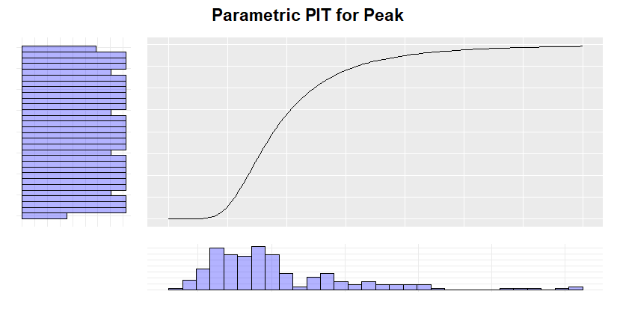
Appendix - PIT
Notes:
Concept of PIT:
We used empirical CDF
> Then, CDF is step function and not smooth
> The transformed variables are „psuedo obs“

Slide 29
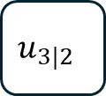
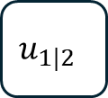

Methods – Construction Vines
$$C_{12}$$
$$C_{23}$$
$$u_{1}$$
$$u_{2}$$
$$u_{3}$$
$$C_{13|2}$$
$$u_{1|2}$$
$$u_{3|2}$$

